Slide 1
Digital product design
Lecture 10: Designing Recommender Systems
Alex Moehring

Slide 2
Administrative
Project surveys distributed last week, please take them!
Final assignment due Friday

Slide 3
Overview
Introduction to content platforms and recommender systems
Technology behind recommender systems
Impact of recommender systems

Slide 4
Human vs algorithmic decisions Review

Slide 5
Comparative Advantage of Humans vs Algorithm
Algorithmic decisions
Instantaneous
Consistent
Makes good use of training data
Objective is clear
Human decisions
Able to use additional data
More explainable?

Slide 6
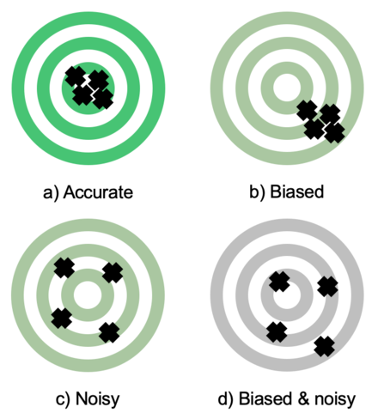
Many Well-Documented Human Prediction Errors
Representativeness
Conjunction Fallacy
Base Rate Fallacy
Confirmation Bias
Noisy Decisions
Mood, time of day, …

Slide 7
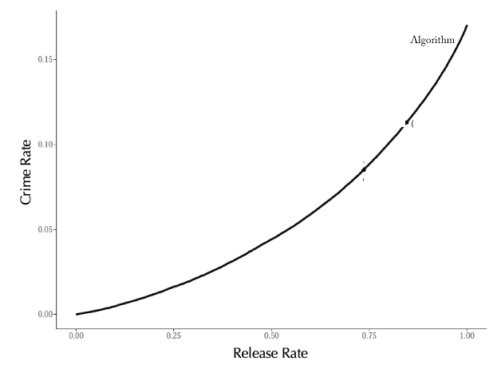
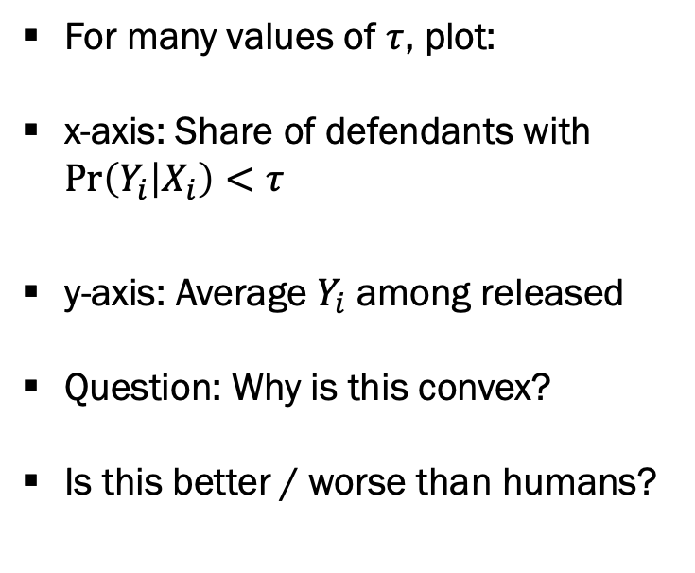
Evaluating Algorithm Decisions
For many values of $τ$, plot:
x-axis: Share of defendants with $\operatorname{Pr}\left(Y_{i} | X_{i}\right)<τ$
y-axis: Average $Y_{i}$ among released
Question: Why is this convex?
Is this better / worse than humans?
Source: Kleinberg et al (2018)

Slide 8
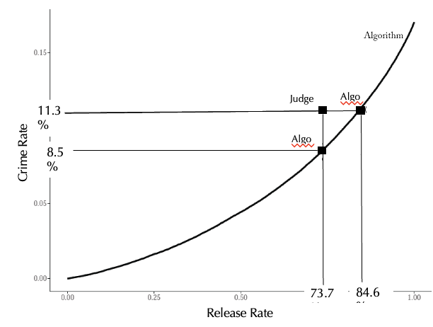
Evaluating Algorithm Decisions, Continued
Add performance of human judge
Keep jail population fixed
Reduce crime rate by 24%
Keep crime rate fixed, reduce jail population by 40%!
Algorithm seems to improve on human decisions!
Source: Kleinberg et al (2018)

Slide 9
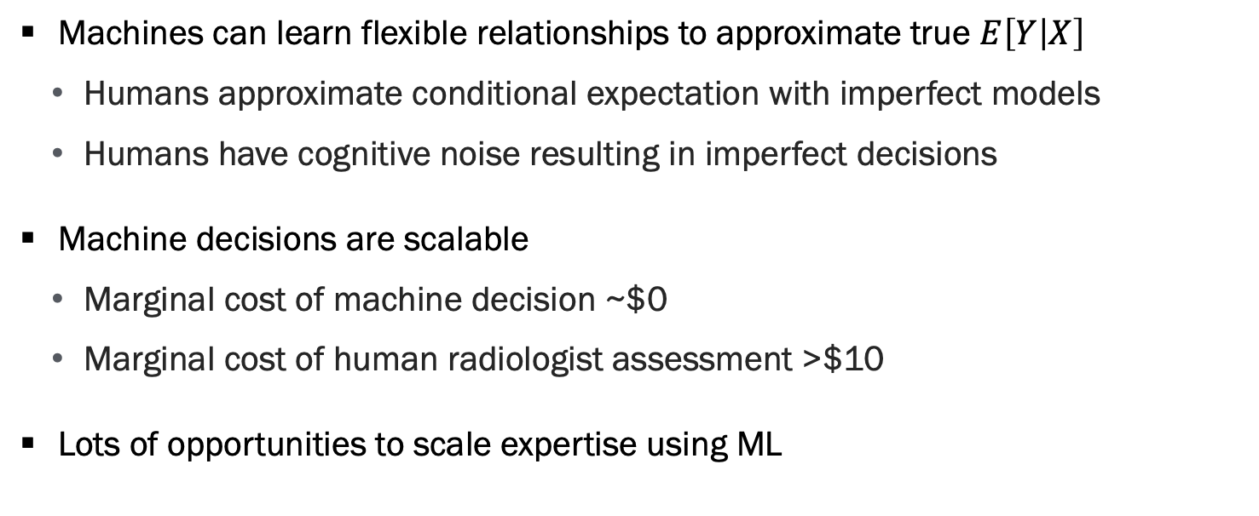
Promise of Algorithmic Decision Making
Machines can learn flexible relationships to approximate true $E\left[Y | X\right]$
Humans approximate conditional expectation with imperfect models
Humans have cognitive noise resulting in imperfect decisions
Machine decisions are scalable
Marginal cost of machine decision ~$0
Marginal cost of human radiologist assessment >$10
Lots of opportunities to scale expertise using ML

Slide 10
Why recommender systems?

Slide 11

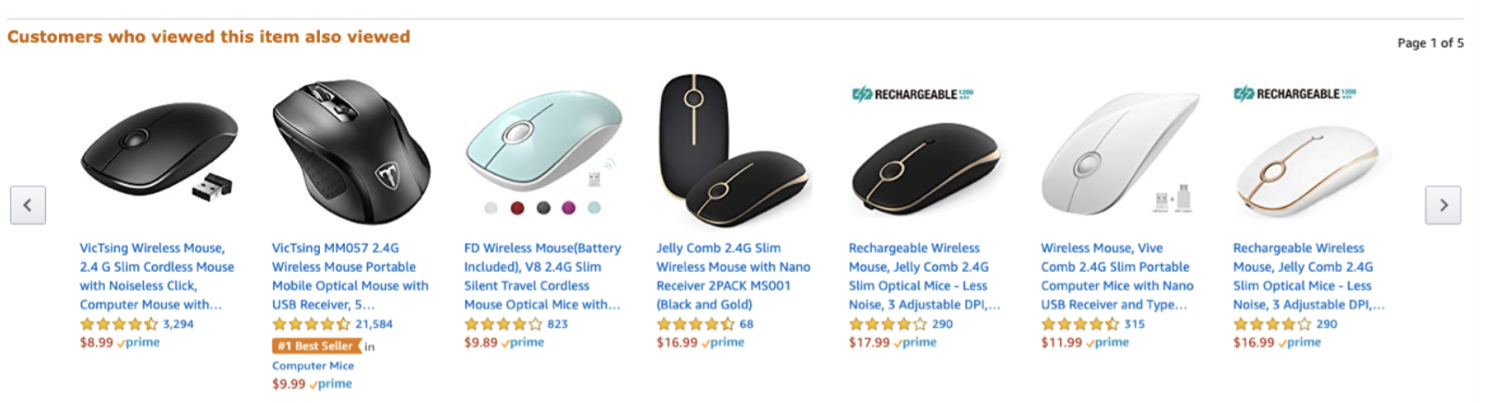
Recommender Systems are Everywhere
Based off slides provided by Shan Huang

Slide 12
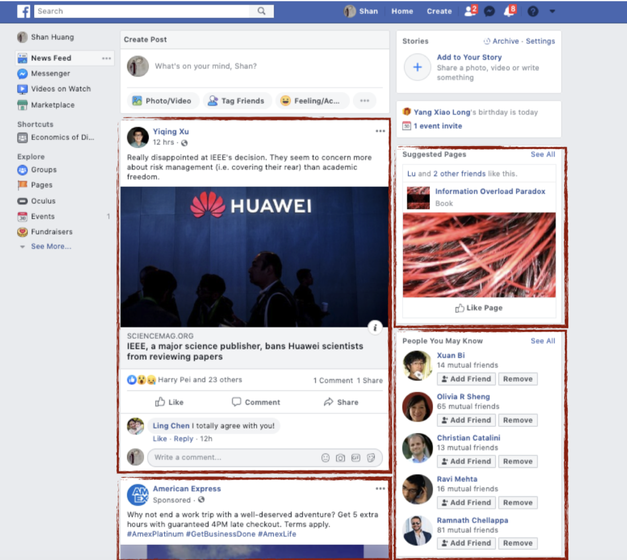
Recommender Systems are Everywhere, Part 2
Based off slides provided by Shan Huang

Slide 13
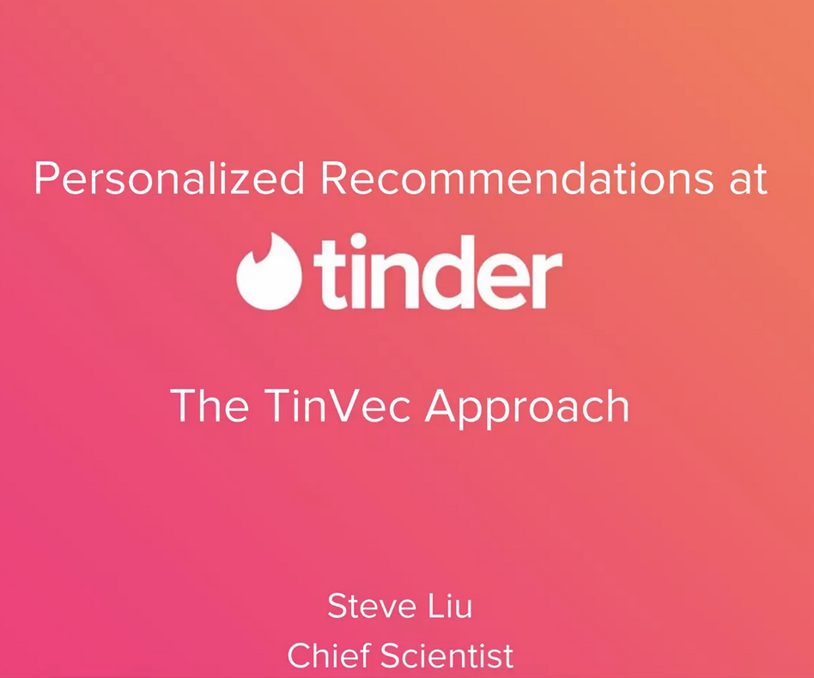
Recommender Systems are Everywhere, Part 3

Slide 14
Recommender Systems are Everywhere, Part 4
Recommender systems curate items for users
Could be content, people, products, jobs, …
Question: Why are recommender systems present in the digital economy?
Information overload
Too many items
Too much information for each item
Without recommender system, user is overwhelmed

Slide 15
Excessive Choice
“On a regular day at a local food market, people would find a display table with 24 different kinds of jams. Then on another day, at that same food market, people were given only 6 different types of jam choices.” (Iyengar and Lepper, 2000)
Results
Big display table (with 24 jams) generated more interest
People far less likely to purchase a jar of jam than in the case of the smaller display (about ten times less likely)
Too many options can overwhelm customers / users

Slide 16
Size of the “Item” Space
Number of new book titles grew from 122,000 in 2000 to 3.1 million in 2010
Number of new albums quadrupled from 2000 to 2010
300 hours of video uploaded to YouTube every minute
Recommender systems allow us to more efficiently search through this vast space

Slide 17
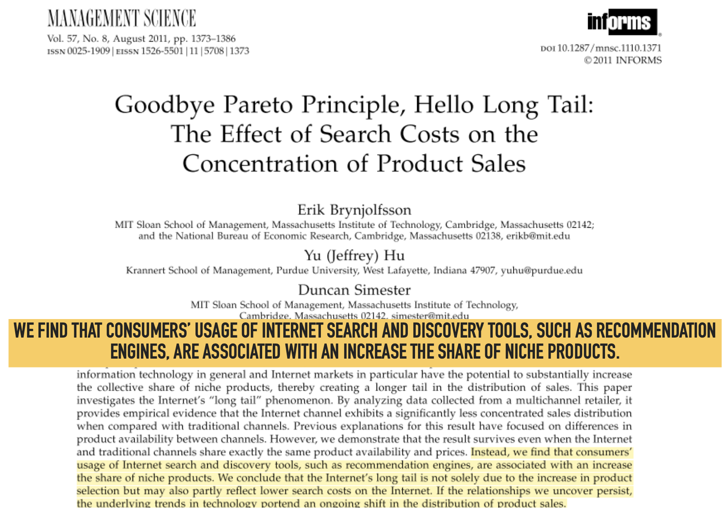
Recommender Systems Increase Demand for Niche Products

Slide 18
Personalized Recommendations are Key Component
Recommendations are typically personalized
System will show different recommendations to different users depending on preferences / engagement patterns
Question: Why would non-personalized recommender not show many niche products?
Hint: Is a physical store personalized?

Slide 19
Technology behind Recommender systems

Slide 20
Data for Recommender Systems
Self-reported data: Characteristics, demographics, stated preferences
Behavioral data:
Explicit feedback: Ratings, likes
Implicit feedback: Clicks, completed movie, make a purchase
Content:
Manual or automated feature engineering

Slide 21
Types of Recommender Systems
Use Netflix as a concrete example
Problem is to recommend movies to users that user will like!
How would you go about tackling this problem?
What challenges will you encounter?
Two dominant approaches
Content-based recommendations
Collaborative filtering

Slide 22
Content Based Recommendations
Typical supervised machine learning problem
For each user, we observe movies they watched and their ratings
Or movies they choose to watch / didn’t watch
We can construct features for these movies
E.g. Genre, cast, length, language, …
Learn a function that maps features to ratings
Challenge 1: Each user has limited history
Challenge 2: Hard to manually construct rich feature space at scale

Slide 23
Collaborative Filtering
Ignore information about users and content
Use the behavioral data from historical users to predict what movies new users are likely to watch and/or rate highly
Borrows data across users / items
Main types:
User-User
Item-Item
Matrix Factorization

Slide 24
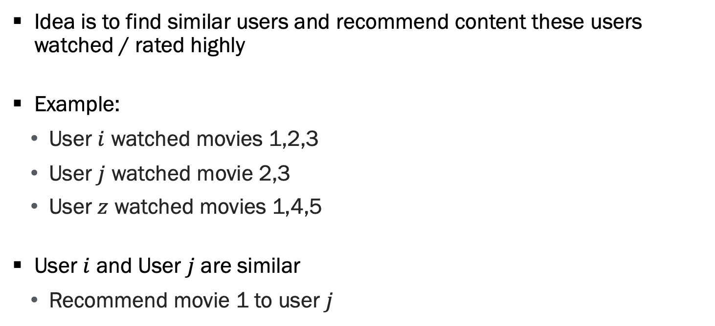
User-User Collaborative Filtering
Idea is to find similar users and recommend content these users watched / rated highly
Example:
User $i$ watched movies 1,2,3
User $j$ watched movie 2,3
User $z$ watched movies 1,4,5
User $i$ and User $j$ are similar
Recommend movie 1 to user $j$

Slide 25
User-User Collaborative Filtering, Continued
How to find similar users?
Similar behaviors
Similar focal behaviors
Similar “other” behaviors (e.g. similar TV patterns if recommending movies)
Similar characteristics
Demographics, networks, expressed interests

Slide 26
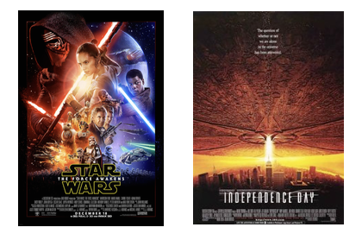
Item-Item Collaborative Filtering
Idea is to find similar items and recommend similar items to those a user has viewed / rated highly
Since 90% of those who liked Star Wars also liked Independence Day, and you liked Star Wars
You may also like Independence Day

Slide 27
Item-Item Collaborative Filtering, Continued
How to find similar items?
Use the “watch” network
Users who watched / liked Star Wars also watched / liked Independence Day
Use item features
Genre, actors, learned features (e.g. embeddings)

Slide 28
Comparing Them
Item-Item method is typically more stable than user-user method
Often fewer items than users, easier to learn relationships
Items often more stable over time while users come and go

Slide 29

Putting these Together: Matrix Factorization

Slide 30
Netflix Prize
Open competition for Best Recommendation Algorithm
Over 50,000 participants
Goal is to predict user ratings for films
Input data:
Previous ratings
Film titles & year
Winner: 10% accuracy
Used a collaborative filtering algorithm to win

Slide 31
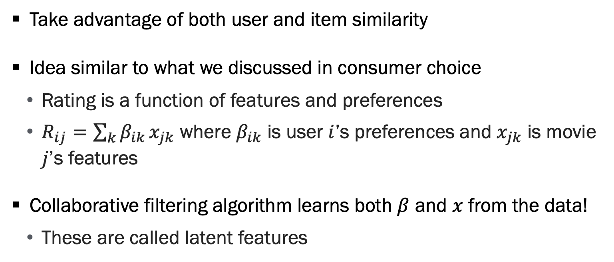
Matrix Factorization
Take advantage of both user and item similarity
Idea similar to what we discussed in consumer choice
Rating is a function of features and preferences
$R_{ij}=\sum_{k}{β_{ik}}x_{jk}$ where $β_{ik}$ is user $i$’s preferences and $x_{jk}$ is movie $j$’s features
Collaborative filtering algorithm learns both $β$ and $x$ from the data!
These are called latent features

Slide 32
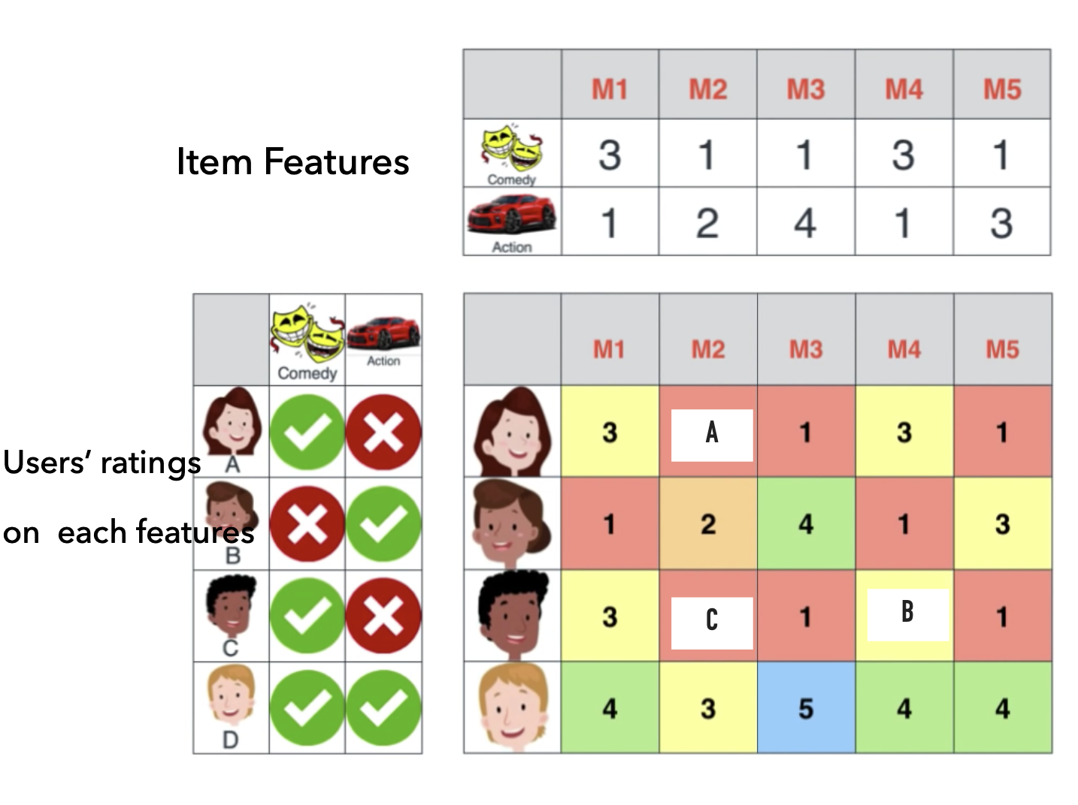
Matrix Factorization, Part 2

Slide 33
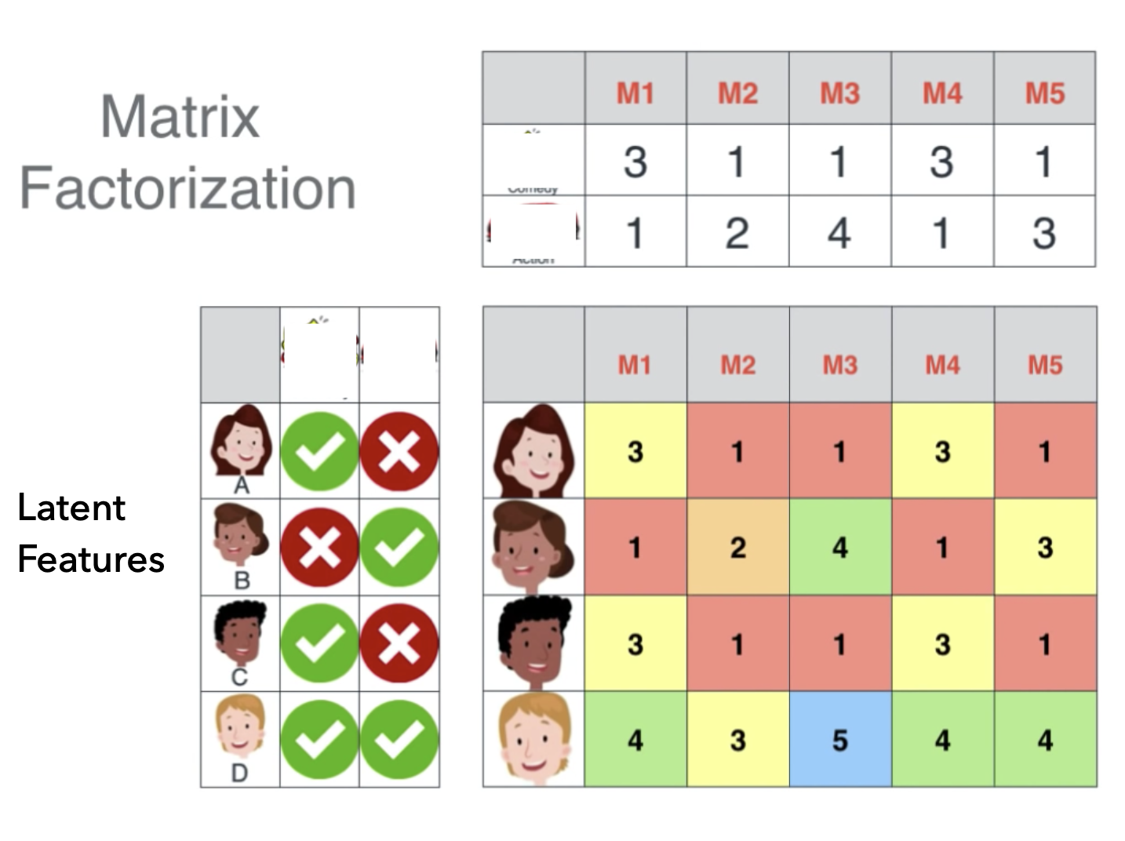
Matrix Factorization, Part 3

Slide 34
Collaborative Filtering Recap
Recommend similar items to similar users
User-user: Recommend same items to similar users
Item-item: Recommend similar items to same users
Matrix factorization (most common): Take advantage of both similar users and similar items
These are different ways of predicting whether a user will:
Watch a movie
Rate the movie highly

Slide 35
Modern Algorithms Combine These
Modern recommender systems often use complicated neural networks to predict ratings
Combine the benefits of content-based and collaborative filtering-based recommender systems
These are complicated systems that have the same output:
A prediction of how likely a user will watch or rate highly a piece of content

Slide 36
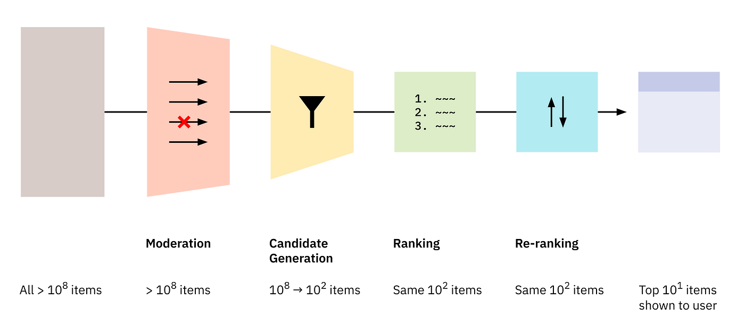
Modern Recommendations

Slide 37
Impact of Rec sys

Slide 38
Impact of Recommender Systems
Solid evidence that personalized recommendations have significant impacts on quantity of engagement / sales
Do recsys impact the type of items users tend to select?
Diversity of items
Quality of items
Prices
Do recommended creators respond?

Slide 39

How do Recommender Systems Impact Diversity of Content?
Experiment at Spotify introduced personalized recommendations for podcasts
Asked how recommender system impacted
Quantity of streams
Individual diversity of streams
Aggregated diversity of streams

Slide 40
How do Recommender Systems Impact Diversity of Content? (Cont.)
Quantity of streams: Increased streams by ~30%
Individual diversity of streams: Individual diversity falls
Each person streams more similar types of content
Easy to see how this could happen on e.g. YouTube’s recommended videos
Aggregate diversity of streams: Increased aggregate diversity
Different people stream different types of podcasts
Evidence of recommendations increasing long-tail

Slide 41
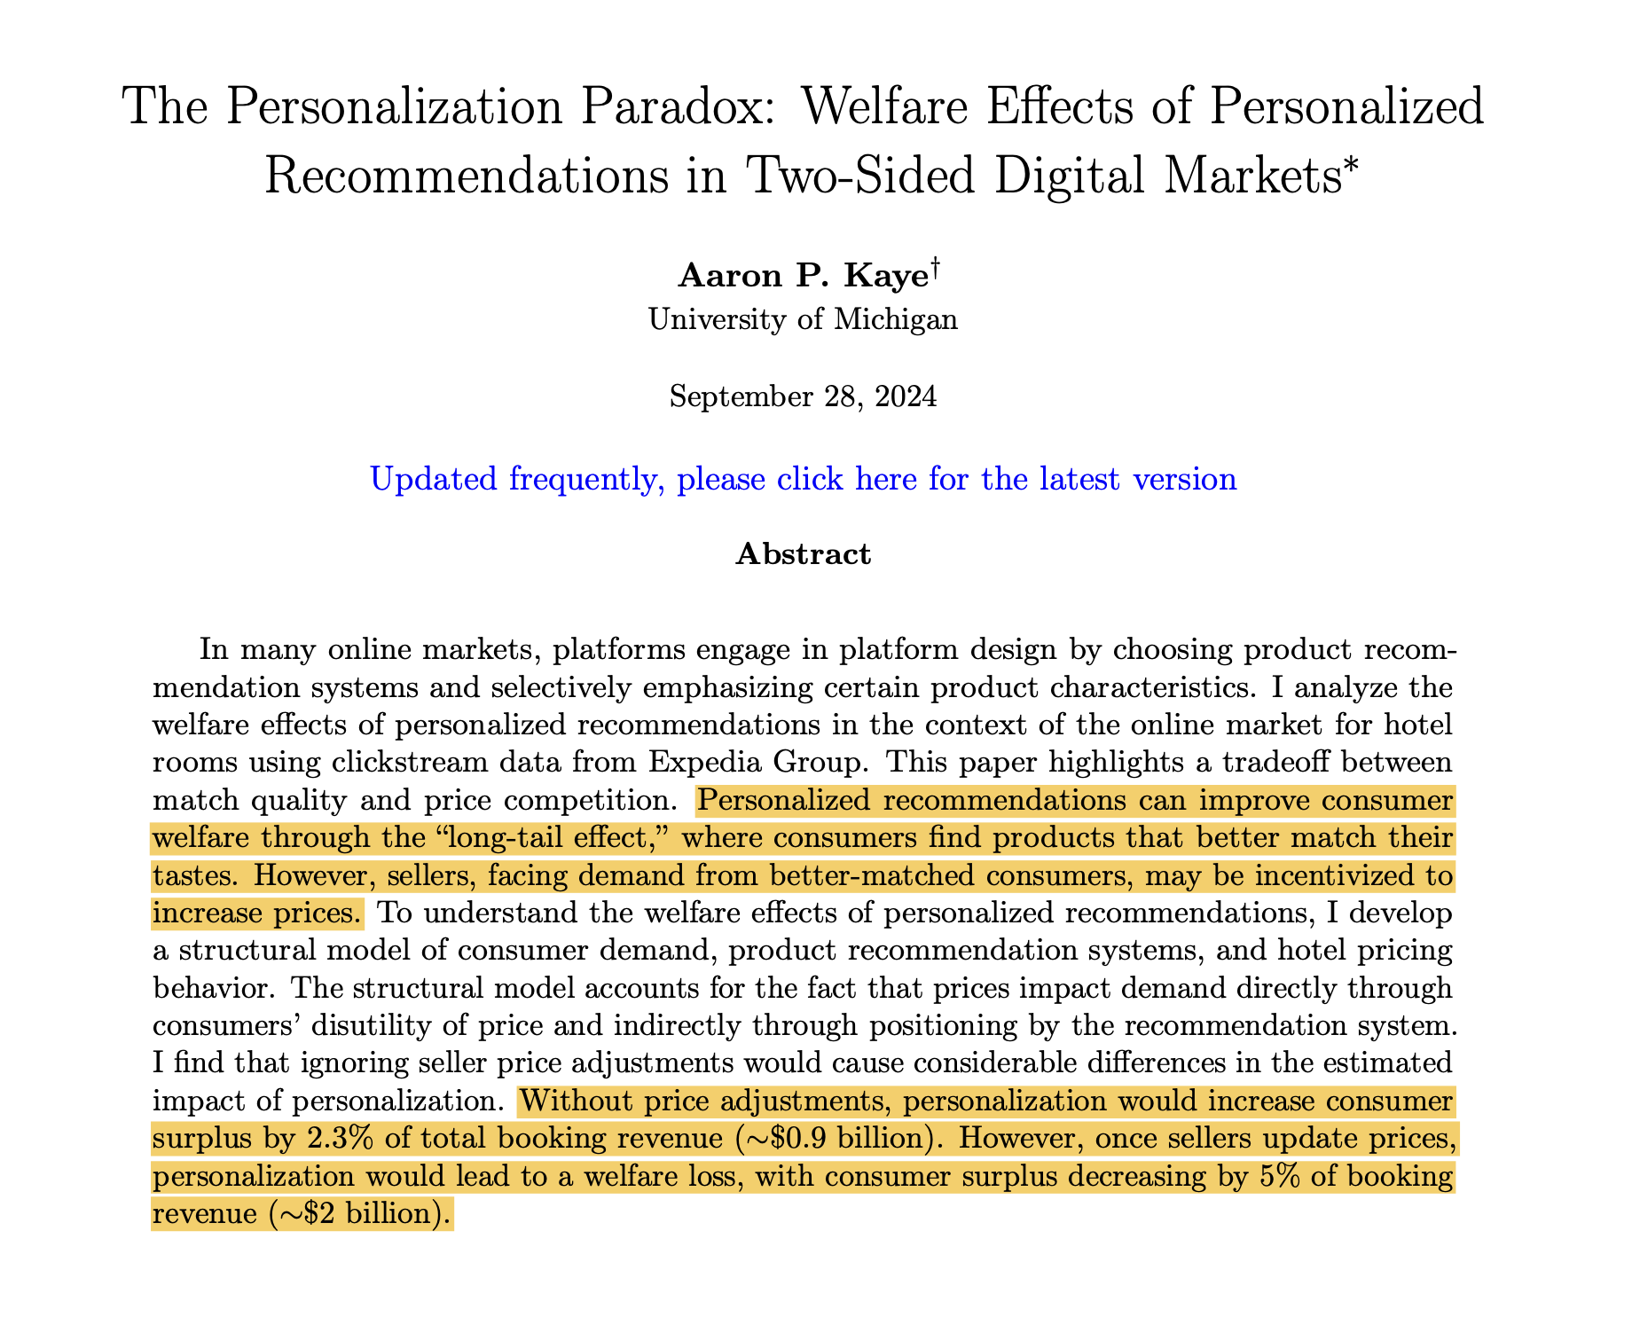
How do Recommender Systems Impact Consumer Surplus?
First pass: Consumers see what they want, must be good for consumers!
Recent research: Personalization softens price competition
Tradeoff between relevance and competition
Intuition: Are you more price elastic for your favorite brand or a random brand?

Slide 42
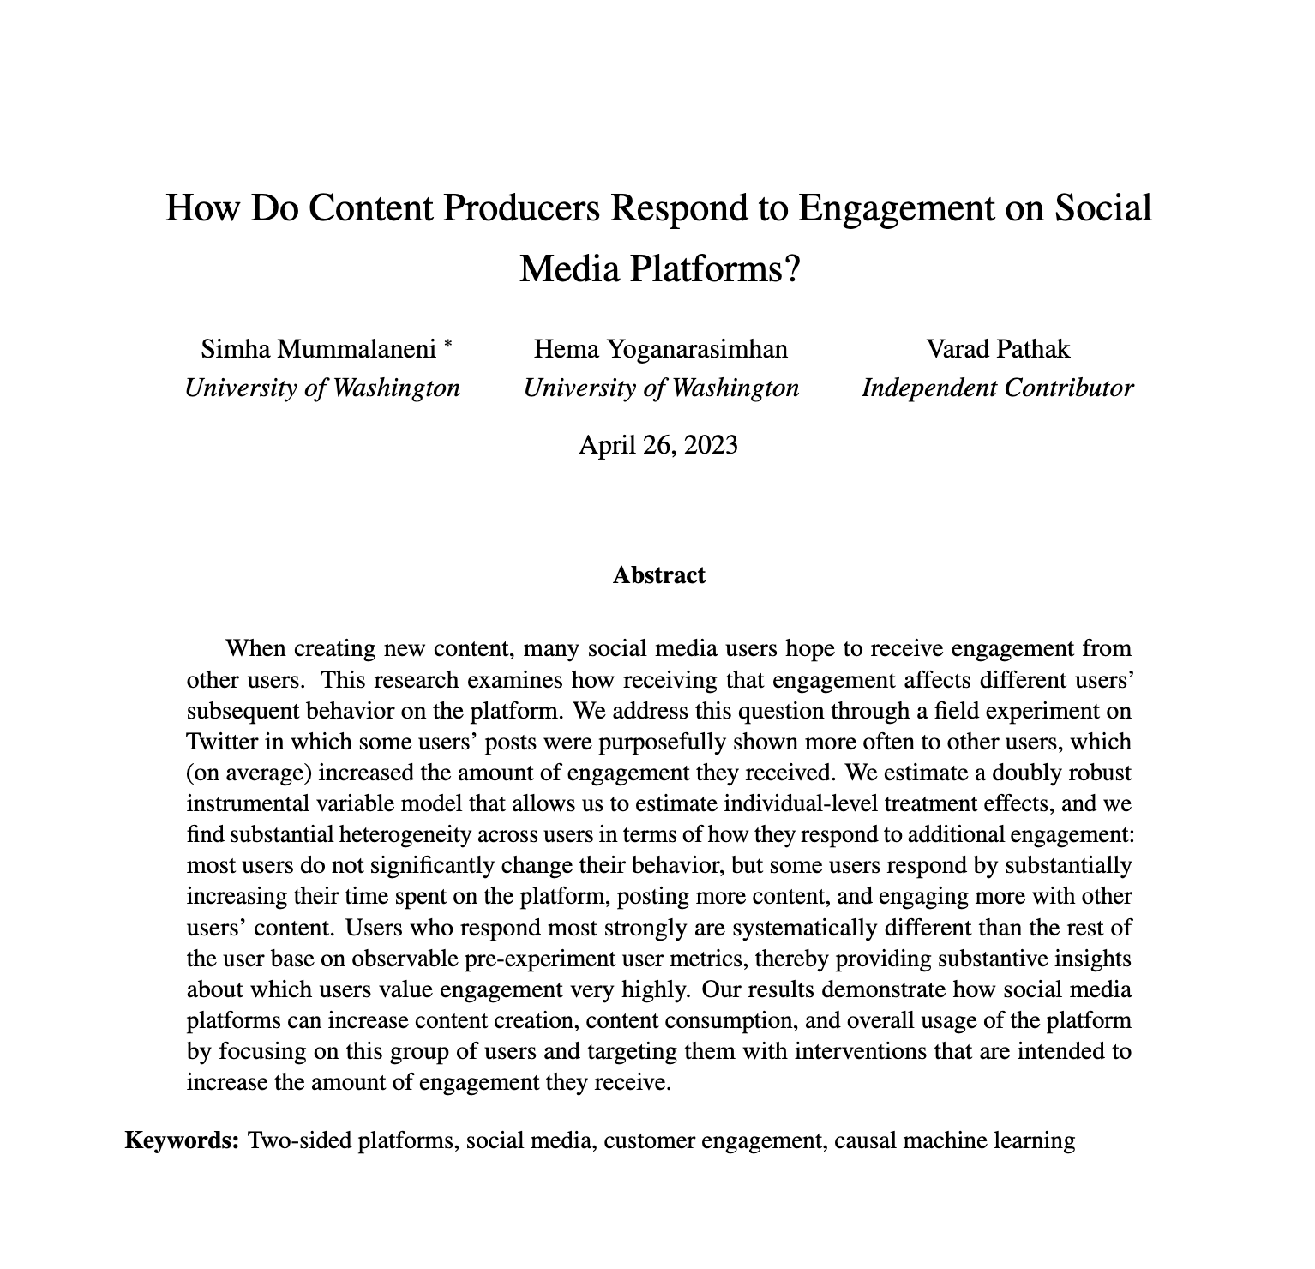
How do creators respond to being recommended?
Experiment on Twitter randomly boosted certain creators
Found most users have weak response to additional attention
A subset of inactive users have larger treatment effects
Suggests targeting these users a useful way to stimulate content production

Slide 43
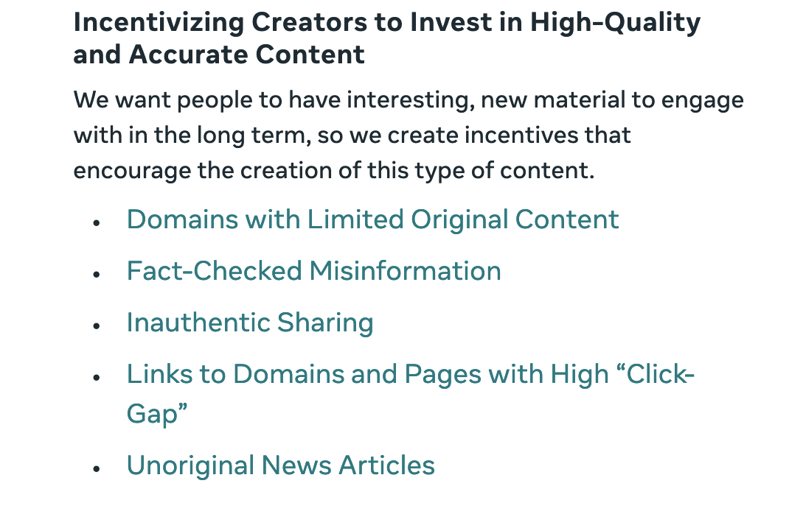
Incentivizing content via recommendations

Slide 44
Impact of Recommender Systems, Continued
Recommendations increase sales / engagement
Evidence that personalization decreases individual diversity
Evidence that recommendations soften price competition
Has an impact on creators
Can incentivize content production and different types of production

Slide 45
Designing recommendations

Slide 46
Recommender Systems Recap
We have an algorithm that generates a prediction of how likely a user will watch a movie, rate the movie highly, etc
An important input for the recommendations we show users
But not the only input!
This would treat engagement as the sole objective
We talked about risks of engagement-based rankings

Slide 47
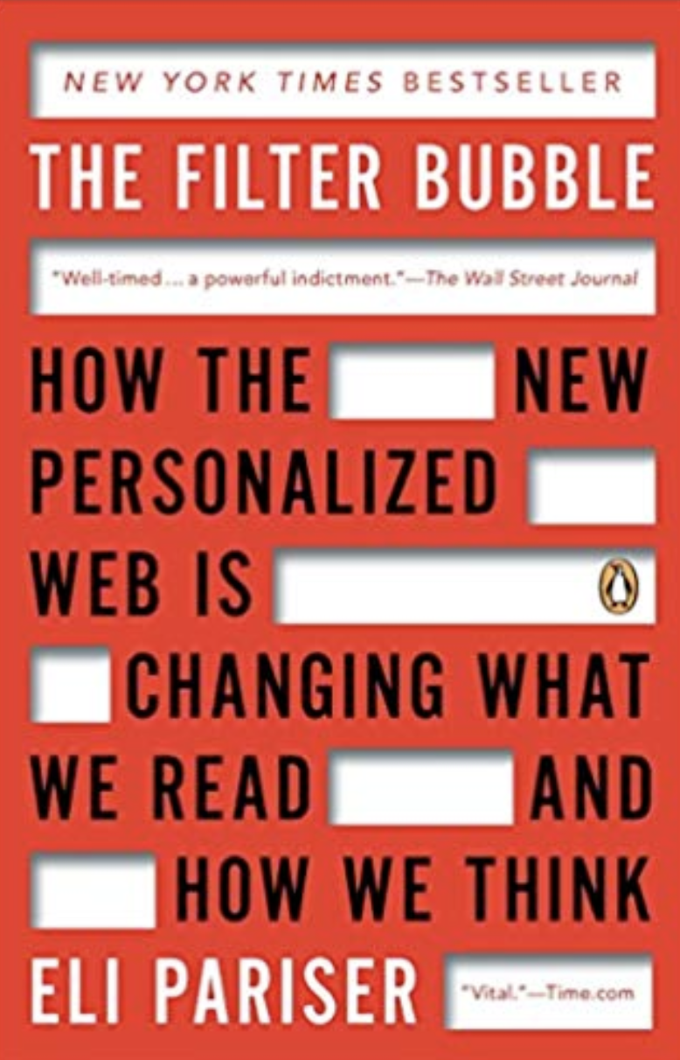
Challenges of Engagement-Only Recommendations

Slide 48
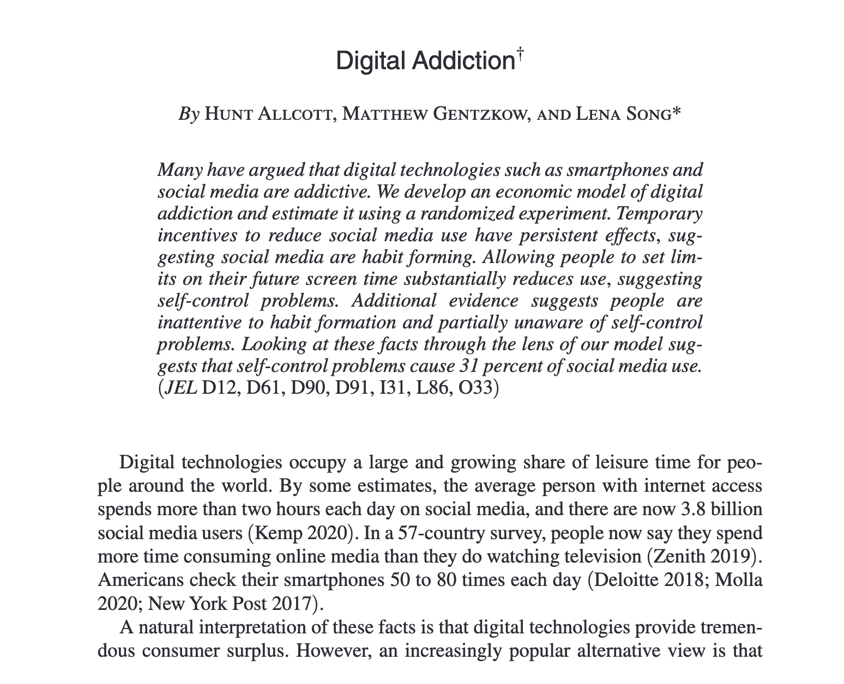
Challenges of Engagement-Only Recommendations, Continued

Slide 49
Designing Final Recommendations
Often our OEC is different from just engagement
Rank content to maximize the OEC rather than engagement alone
This often manifests as ranking by a linear combination of:
Predicted engagement / rating
Profit margin
Diversity of content
“Quality” of content
…

Slide 50
An Encouraging Result
Recent research has found putting weight on non-engagement outcome is not too costly for engagement
Implication: If we care about more than just short-term engagement, we can impact these metrics for small changes in engagement
Is it clear why this is an encouraging result?

Slide 51
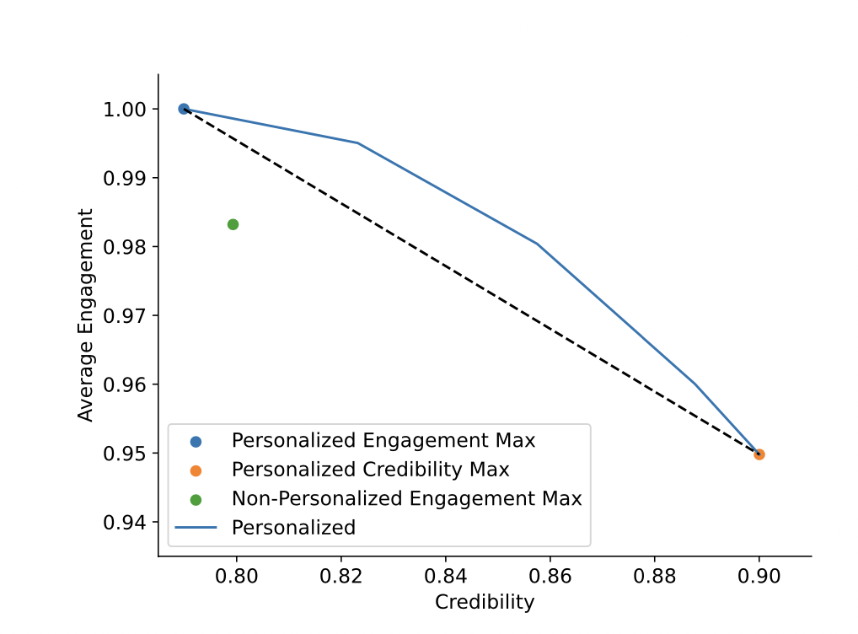
Example 1: Credibility of News Content

Slide 52
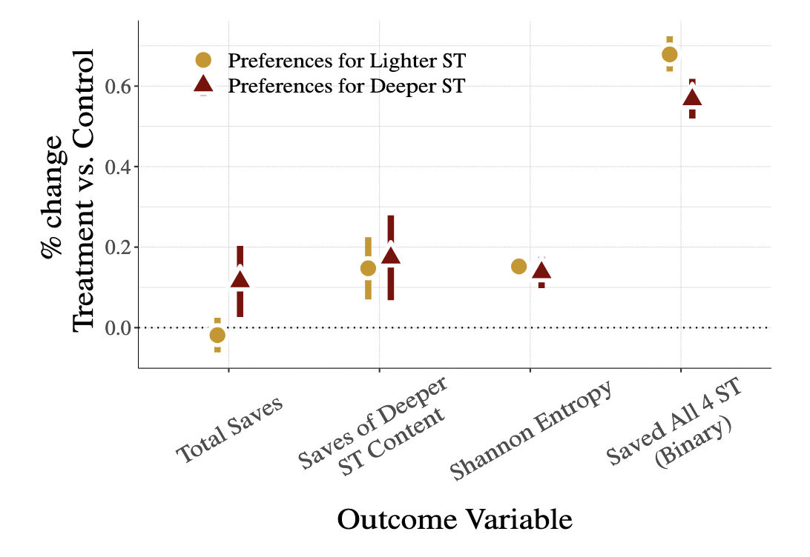
Example 2: Inclusive Recommendations at Pinterest
Source: Kumar et al (2024)

Slide 53
Question
You work at Amazon designing their recommendation system, what might your ranking objective function look like?

Slide 54
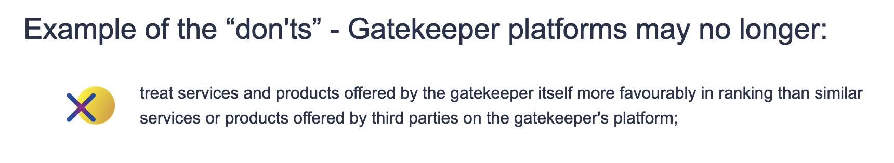
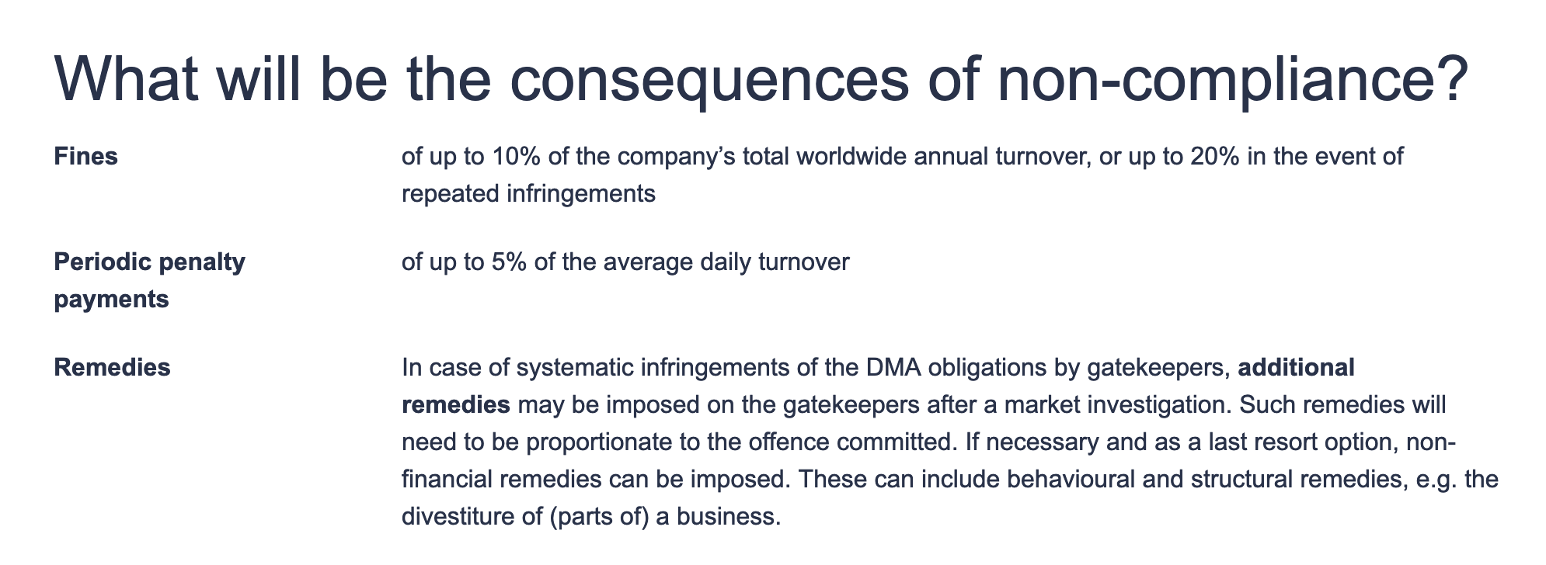
Self-Preferencing
Not permitted under the EU’s DMA

Slide 55
Questions

